Slide 1
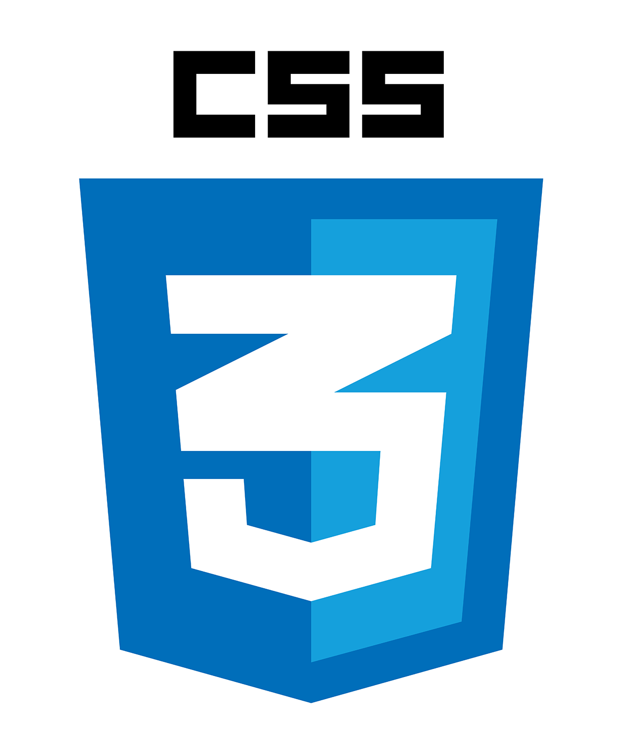
CASCADING STYLE SHEETS
Where every detail matters
MGA PAG UUSAPAN
Introduction…
Core Concepts of CSS…
Versions and Evolutions…
CSS Framework…
Ways to insert CSS..

Slide 2
<!DOCTYPE html>
<html lang="en">
<head>
<meta charset="UTF-8">
<meta name="viewport" content="width=device-width, initial-scale=1.0">
<title>HTML with CSS</title>
<link rel="stylesheet" href="styles.css">
</head>
<body>
<header>
<h1>Cascading Style Sheets</h1>
</header>
<section>
<article>
<h2>I. Introduction</h2>
<p>CSS stands for Cascading Style Sheets.
<br>The presentation and styling of HTML (Hypertext Markup Language) and XML (eXtensible Markup Language)
<br>documents are described using this stylesheet language in web development.
<br>By giving developers control over the look, feel, and formatting of web pages,
<br>CSS makes it possible to keep a document's structure and content independent from its visual presentation.</p>
<ul>
<li>Define the visual aspects of a webpage.</li>
<li>Control layout, colors, fonts, and other stylistic elements.</li>
<li>Facilitate a modular and maintainable approach to web design.</li>
<li>Target specific HTML elements using selectors.</li>
<li>Separate content and style for improved organization.</li>
<li>Create visually appealing and responsive user interfaces.</li>
</ul>
</article>
</body>
</html>

Slide 3
Cascading Style Sheets
I. Introduction
CSS stands for Cascading Style Sheets.
The presentation and styling of HTML (Hypertext Markup Language) and XML (eXtensible Markup Language)
documents are described using this stylesheet language in web development.
By giving developers control over the look, feel, and formatting of web pages,
CSS makes it possible to keep a document's structure and content independent from its visual presentation.
  Define the visual aspects of a webpage.
  Control layout, colors, fonts, and other stylistic elements.
  Facilitate a modular and maintainable approach to web design.
  Target specific HTML elements using selectors.
  Separate content and style for improved organization.
  Create visually appealing and responsive user interfaces.

Slide 4


ChatGRP 2.0
ChatGRP
Fast backwards in 1990 HTML was invented by Berners-Lee to create electronic pages that are displayed on the World Wide Web, each page contains a series of connections to other pages called hyperlinks.
CSS (Cascading Style Sheets) was first proposed by Håkon Wium Lie on October 10, 1994 while working with Tim Berners-Lee at CERN and the rest is history. CSS was not the only styling language in development at the time, but the very element of cascading and developing sequence is what set it apart from the rest. CSS 1 was released in 1996, and republished with corrections in 1999. CSS 2 appeared in 1998 and built on CSS 1.
CSS 2 adds support for different output media.
After CSS 2.1, CSS itself has been modularized, such that each module can be developed independently of the rest. This allows not just for existing modules to be leveled independently, but new modules to be created at any time, either defining completely new sets of features, or extending from existing CSS 2.1 features.
CSS now has more than 60 modules that define different capabilities, some already part of the standard, some still in development. The term CSS3 refers to everything published after CSS 2.1, there is no single integrated CSS4 specification.
All about the History Background of CSS

Slide 5
II. CORE CONCEPTS OF CSS
<previous
Next>
CSS SELECTORS
A CSS selector selects the HTML element(s) you want to style. CSS selectors are used to "find" (or select) the HTML elements you want to style. There are various types of selectors, each serving a different purpose:
ELEMENT SELECTOR
The element selector selects HTML elements based on the element name. For example, ‘p’ selects all ‘<p>’ paragraph in the document.
  p {
  text-align: center;
  color: red;
  }
Try it yourself>>

Slide 6
Run >
<previous
<!DOCTYPE html>
<html>
<head>
<style>
p {
text-align: center;
color: red;
}
</style>
</head>
<body>
<p>Every paragraph will be affected by the style.</p>
<p id="para1">Me too!</p>
<p>And me!</p>
</body>
</html>
Every paragraph will be affected by the style.
Me too!
And me!

Slide 7
II. CORE CONCEPTS OF CSS
<previous
Next>
CLASS SELECTORS
The class selector selects HTML elements with a specific class attribute.
To select elements with a specific class, write a period (.) character, followed by the class name.
For example, ‘.button’ selects all element with the class ‘button’.
  Example
  In this example all HTML elements with class="center" will be red and center-aligned:
  .center {
  text-align: center;
  color: red;
  }
Try it yourself>>

Slide 8
Run >
<previous
<!DOCTYPE html>
<html>
<head>
<style>
.center {
text-align: center;
color: red;
}
</style>
</head>
<body>
<h1 class = “center”>Red and center-aligned heading</h1>
<p class = “center”>Red and center-aligned paragraph.</p>
</body>
</html>
Red and center-aligned heading
Red and center-aligned paragraph.

Slide 9
II. CORE CONCEPTS OF CSS
<previous
Next>
ID SELECTORS
The id selector uses the id attribute of an HTML element to select a specific element.
The id of an element is unique within a page, so the id selector is used to select one unique element!
To select an element with a specific id, write a hash (#) character, followed by the id of the element.
  Example
The CSS rule below will be applied to the HTML element with id="para1":
  #para1 {
  text-align: center;
  color: red;
  }
Try it yourself>>

Slide 10
Run >
<previous
<!DOCTYPE html>
<html>
<head>
<style>
#para1 {
text-align: center;
color: red;
}
</style>
</head>
<body>
<h1 id = “para1”>Hello World!</h1>
<p>This paragraph is not affected by the style.</p>
</body>
</html>
Hello World
This paragraph is not affected by the style.

Slide 11
II. CORE CONCEPTS OF CSS
<previous
Next>
UNIVERSAL SELECTORS
The universal selector (*) selects all HTML elements on the page.
  Example
The CSS rule below will affect every HTML element on the page:
  * {
  text-align: center;
  color: blue;
  }
Try it yourself>>

Slide 12
Run >
<previous
<!DOCTYPE html>
<html>
<head>
<style>
* {
text-align: center;
color: blue;
}
</style>
</head>
<body>
<h1>Hello World!</h1>
<p>Every element on the page will be affected by the style.</p>
<p id="para1">Me too!</p>
<p>And me!</p>
</body>
</html>
Hello world!
Every element on the page will be affected by the style.
Me too!
And me!

Slide 13
ChatGRP 2.0
ChatGRP
Targeted elements' visual attributes are specified by their CSS properties, and the particular styling that is applied to those properties is determined by their values.
Properties include many different characteristics of design, such as:
Box Model Properties: properties such as ‘width’, ‘height’, ‘margin’, ‘padding’, ‘border’ control the size, spacing, and the layout of the elements with the document’s layout.
Typographic Properties: Properties like ‘font-family’, ‘font-weight, ‘font-size’, line-height’, ‘text-align’ dictate the appearance of text content, allowing developers to customize font styles and alignments.
Colors and Backgrounds: CSS enables developers to specify colors using properties like ‘color’ and ‘background-color’, as well as background images with ‘background-image’ and related properties.
Flexbox and Grid Properties: With the advent of Flexbox and Grid layouts, CSS provides properties such as ‘display’, ‘flex-direction’, ‘justify-content’, ‘align-items’, ‘grid-template-columns’, and ‘grid-template-rows’ to create flexible and responsive layouts.
CSS Properties and Values

Slide 14
CASCADING STYLE SHEETS
III. Versions and Evolutions
CASCADING STYLE SHEETS
Key Features and Enhancements in each Version.
CSS1 (1996): The first official version of CSS introduced basic styling capabilities for HTML documents. It included properties for text, colors, and layout, but it was relatively limited compared to later versions.
CSS2 (1998): Building upon CSS1, CSS2 brought more advanced features such as positioning, absolute and relative positioning, and the introduction of media types for print and screen. It also introduced support for internationalization.
CSS3 (Working Drafts from 1999, Modules ongoing): Rather than a single comprehensive release, CSS3 is a collection of modules, each introducing new features and improvements. This modular approach allows for more frequent updates to specific aspects of styling without requiring a complete overhaul.
CSS1: Introduced basic styling features like font properties, color, and text alignment. It laid the foundation for web styling but was limited in its capabilities.
CSS2: Expanded layout capabilities with absolute and relative positioning. It introduced support for media types, allowing styles to be applied differently based on whether the content was intended for print or screen.
CSS3: This version brought a plethora of new features and modules, including but not limited to:
Selectors: Expanded with more sophisticated selectors for precise targeting.
Media Queries: Enabled responsive design by allowing styles to adapt based on device characteristics.
Transitions and Animations: Introduced properties for creating smooth transitions and animations.
Flexbox and Grid Layout: Revolutionized layout design with flexible and grid-based structures.

Slide 15
CASCADING STYLE SHEETS
IV. CSS FRAMEWORK
CASCADING STYLE SHEETS
Versions and Evolutions
CASCADING STYLE SHEETS
Key Features and Enhancements in each Version.
What is a CSS Framework?
A CSS framework is a pre-prepared library of code to help implement fast and consistent website styling and layouts. Frameworks include pre-written, reusable code for common design elements and components that can be easily applied to base HTML to create familiar and consistent user interfaces or website designs.
CSS frameworks are used by front-end developers to quickly deploy things like responsive grids, styled forms, buttons, or other important UI elements on web pages and apps.
Benefits of Using a CSS Framework
Okay, but why bother using a framework?
Couldn’t you just build all of this stuff yourself? Well, yeah. But that’s kind of the point. Frameworks are the inevitable outcome of a world where designers and developers write the same basic CSS over and over again for each website or app.
Why not just write it once and use it everywhere? That’s why they exist.
CSS1 (1996): The first official version of CSS introduced basic styling capabilities for HTML documents. It included properties for text, colors, and layout, but it was relatively limited compared to later versions.
CSS2 (1998): Building upon CSS1, CSS2 brought more advanced features such as positioning, absolute and relative positioning, and the introduction of media types for print and screen. It also introduced support for internationalization.
CSS3 (Working Drafts from 1999, Modules ongoing): Rather than a single comprehensive release, CSS3 is a collection of modules, each introducing new features and improvements. This modular approach allows for more frequent updates to specific aspects of styling without requiring a complete overhaul.
CSS1: Introduced basic styling features like font properties, color, and text alignment. It laid the foundation for web styling but was limited in its capabilities.
CSS2: Expanded layout capabilities with absolute and relative positioning. It introduced support for media types, allowing styles to be applied differently based on whether the content was intended for print or screen.
CSS3: This version brought a plethora of new features and modules, including but not limited to:
Selectors: Expanded with more sophisticated selectors for precise targeting.
Media Queries: Enabled responsive design by allowing styles to adapt based on device characteristics.
Transitions and Animations: Introduced properties for creating smooth transitions and animations.
Flexbox and Grid Layout: Revolutionized layout design with flexible and grid-based structures.

Slide 16
CASCADING STYLE SHEETS
IV. CSS FRAMEWORK
CASCADING STYLE SHEETS
IV. CSS FRAMEWORK
CASCADING STYLE SHEETS
Key Features and Enhancements in each Version.
Benefits of Using a CSS Framework
Speed Up Development Time
- The simplest answer as to why people use frameworks: Speed. Frameworks come out of the box with plenty of elements and styles you would otherwise need to build from scratch when developing a website.
Consistent Style and Design
- The other key benefit of using a CSS framework is that all of your styles, UI elements, buttons, and more will look consistent out of the box. You won’t have to spend hours (or days or weeks or years) tweaking individual styles to ensure they all have the same padding, spacing, and font sizes.
Since the framework has already been meticulously crafted, all the tedious work is done.
As an added benefit, the most popular CSS frameworks are widely used, helping the website look and feel familiar to users. That’s clutch from a UX standpoint.
Improve Collaboration and Maintainability
- Since most frameworks come with an extensive documentation library and a community of users, you get the benefit of a common codebase and extremely well-documented information on exactly how to use said system.
Plus, most of them are open-source projects. That means you can freely use, adapt, and even (in some cases) redistribute your own version if that’s your thing.
What is a CSS Framework?
A CSS framework is a pre-prepared library of code to help implement fast and consistent website styling and layouts. Frameworks include pre-written, reusable code for common design elements and components that can be easily applied to base HTML to create familiar and consistent user interfaces or website designs.
CSS frameworks are used by front-end developers to quickly deploy things like responsive grids, styled forms, buttons, or other important UI elements on web pages and apps.
Benefits of Using a CSS Framework
Okay, but why bother using a framework?
Couldn’t you just build all of this stuff yourself? Well, yeah. But that’s kind of the point. Frameworks are the inevitable outcome of a world where designers and developers write the same basic CSS over and over again for each website or app.
Why not just write it once and use it everywhere? That’s why they exist.
CSS1: Introduced basic styling features like font properties, color, and text alignment. It laid the foundation for web styling but was limited in its capabilities.
CSS2: Expanded layout capabilities with absolute and relative positioning. It introduced support for media types, allowing styles to be applied differently based on whether the content was intended for print or screen.
CSS3: This version brought a plethora of new features and modules, including but not limited to:
Selectors: Expanded with more sophisticated selectors for precise targeting.
Media Queries: Enabled responsive design by allowing styles to adapt based on device characteristics.
Transitions and Animations: Introduced properties for creating smooth transitions and animations.
Flexbox and Grid Layout: Revolutionized layout design with flexible and grid-based structures.

Slide 17
CASCADING STYLE SHEETS
IV. CSS FRAMEWORK
CASCADING STYLE SHEETS
IV. CSS FRAMEWORK
CASCADING STYLE SHEETS
POPULAR CSS FRAMEWORKS
Benefits of Using a CSS Framework
Speed Up Development Time
- The simplest answer as to why people use frameworks: Speed. Frameworks come out of the box with plenty of elements and styles you would otherwise need to build from scratch when developing a website.
Consistent Style and Design
- The other key benefit of using a CSS framework is that all of your styles, UI elements, buttons, and more will look consistent out of the box. You won’t have to spend hours (or days or weeks or years) tweaking individual styles to ensure they all have the same padding, spacing, and font sizes.
Since the framework has already been meticulously crafted, all the tedious work is done.
As an added benefit, the most popular CSS frameworks are widely used, helping the website look and feel familiar to users. That’s clutch from a UX standpoint.
Improve Collaboration and Maintainability
- Since most frameworks come with an extensive documentation library and a community of users, you get the benefit of a common codebase and extremely well-documented information on exactly how to use said system.
Plus, most of them are open-source projects. That means you can freely use, adapt, and even (in some cases) redistribute your own version if that’s your thing.
What is a CSS Framework?
A CSS framework is a pre-prepared library of code to help implement fast and consistent website styling and layouts. Frameworks include pre-written, reusable code for common design elements and components that can be easily applied to base HTML to create familiar and consistent user interfaces or website designs.
CSS frameworks are used by front-end developers to quickly deploy things like responsive grids, styled forms, buttons, or other important UI elements on web pages and apps.
Benefits of Using a CSS Framework
Okay, but why bother using a framework?
Couldn’t you just build all of this stuff yourself? Well, yeah. But that’s kind of the point. Frameworks are the inevitable outcome of a world where designers and developers write the same basic CSS over and over again for each website or app.
Why not just write it once and use it everywhere? That’s why they exist.
Bootstrap
- Bootstrap began as a side project built and shared by developers at Twitter. Now it’s the most widely-used CSS framework for responsive, mobile-first web design. Millions of people use Bootstrap to craft clean, consistent, and familiar web layouts.
Key features:
Responsive grid system
Pre-built UI components
Customizable and extensible themes
Extensive documentation
2. Tailwind CSS
-
The creator, Adam Wathan, wrote something of a manifesto about the thinking behind Tailwind. And essentially, the idea is that CSS shouldn’t be descriptive and semantic. He calls it a utility-first CSS framework.
Key features:
Utility classes for easy styling
Responsive design capabilities
Customizable configuration
Component-friendly approach

Slide 18
CASCADING STYLE SHEETS
IV. CSS FRAMEWORK
CASCADING STYLE SHEETS
CASCADING STYLE SHEETS
POPULAR CSS FRAMEWORKS
POPULAR CSS FRAMEWORKS
Benefits of Using a CSS Framework
Speed Up Development Time
- The simplest answer as to why people use frameworks: Speed. Frameworks come out of the box with plenty of elements and styles you would otherwise need to build from scratch when developing a website.
Consistent Style and Design
- The other key benefit of using a CSS framework is that all of your styles, UI elements, buttons, and more will look consistent out of the box. You won’t have to spend hours (or days or weeks or years) tweaking individual styles to ensure they all have the same padding, spacing, and font sizes.
Since the framework has already been meticulously crafted, all the tedious work is done.
As an added benefit, the most popular CSS frameworks are widely used, helping the website look and feel familiar to users. That’s clutch from a UX standpoint.
Improve Collaboration and Maintainability
- Since most frameworks come with an extensive documentation library and a community of users, you get the benefit of a common codebase and extremely well-documented information on exactly how to use said system.
Plus, most of them are open-source projects. That means you can freely use, adapt, and even (in some cases) redistribute your own version if that’s your thing.
Bootstrap
- Bootstrap began as a side project built and shared by developers at Twitter. Now it’s the most widely-used CSS framework for responsive, mobile-first web design. Millions of people use Bootstrap to craft clean, consistent, and familiar web layouts.
Key features:
Responsive grid system
Pre-built UI components
Customizable and extensible themes
Extensive documentation
2. Tailwind CSS
-
The creator, Adam Wathan, wrote something of a manifesto about the thinking behind Tailwind. And essentially, the idea is that CSS shouldn’t be descriptive and semantic. He calls it a utility-first CSS framework.
Key features:
Utility classes for easy styling
Responsive design capabilities
Customizable configuration
Component-friendly approach
3. Bulma
- Bulma is a lightweight CSS framework based on Flexbox.
The syntax of this framework is plain-language, meaning it relies heavily on descriptive utility classes or modifiers like “.button” and “.is-large”.
Key features:
Flexbox-based grid system
Modular architecture
Sass-powered for easy customization
Minimalistic code and design
2. Foundation
- Foundation makes no qualms about being advanced and, as such, fairly complex compared to some of the other choices. It’s a responsive front-end framework designed for mobile-first development and used for both sites and emails, and it’s used by approximately 500,000 websites worldwide.
Key features:
Responsive grid system
Comprehensive set of UI components
Customizable Sass variables
Integration with popular front-end tools and libraries

Slide 19
CASCADING STYLE SHEETS
CASCADING STYLE SHEETS
CASCADING STYLE SHEETS
POPULAR CSS FRAMEWORKS
POPULAR CSS FRAMEWORKS
POPULAR CSS FRAMEWORKS
Bootstrap
- Bootstrap began as a side project built and shared by developers at Twitter. Now it’s the most widely-used CSS framework for responsive, mobile-first web design. Millions of people use Bootstrap to craft clean, consistent, and familiar web layouts.
Key features:
Responsive grid system
Pre-built UI components
Customizable and extensible themes
Extensive documentation
2. Tailwind CSS
-
The creator, Adam Wathan, wrote something of a manifesto about the thinking behind Tailwind. And essentially, the idea is that CSS shouldn’t be descriptive and semantic. He calls it a utility-first CSS framework.
Key features:
Utility classes for easy styling
Responsive design capabilities
Customizable configuration
Component-friendly approach
3. Bulma
- Bulma is a lightweight CSS framework based on Flexbox.
The syntax of this framework is plain-language, meaning it relies heavily on descriptive utility classes or modifiers like “.button” and “.is-large”.
Key features:
Flexbox-based grid system
Modular architecture
Sass-powered for easy customization
Minimalistic code and design
4. Foundation
- Foundation makes no qualms about being advanced and, as such, fairly complex compared to some of the other choices. It’s a responsive front-end framework designed for mobile-first development and used for both sites and emails, and it’s used by approximately 500,000 websites worldwide.
Key features:
Responsive grid system
Comprehensive set of UI components
Customizable Sass variables
Integration with popular front-end tools and libraries
5. Semantic UI
- “Everything arbitrary is mutable.”
That’s the dogma of Semantic UI.
At its core, this framework is built to help build and scale familiar-feeling interfaces for websites and web applications.
Key features:
Intuitive and human-readable class names
Wide range of UI components and layouts
Customizable themes and styles
Integration with popular JavaScript libraries and frameworks like Angular
6. Materialize
- Materialize CSS framework is based on Google’s Material Design principles. It emphasizes bold visual design and UX-focused animation (motion).Materialize is pretty popular, with over 38,000 stars on GitHub.
Key features:
Material-design-inspired components and styles
Responsive grid system
Sass-powered customization
Built-in JavaScript plugins

Slide 20
CASCADING STYLE SHEETS
CASCADING STYLE SHEETS
POPULAR CSS FRAMEWORKS
POPULAR CSS FRAMEWORKS
3. Bulma
- Bulma is a lightweight CSS framework based on Flexbox.
The syntax of this framework is plain-language, meaning it relies heavily on descriptive utility classes or modifiers like “.button” and “.is-large”.
Key features:
Flexbox-based grid system
Modular architecture
Sass-powered for easy customization
Minimalistic code and design
4. Foundation
- Foundation makes no qualms about being advanced and, as such, fairly complex compared to some of the other choices. It’s a responsive front-end framework designed for mobile-first development and used for both sites and emails, and it’s used by approximately 500,000 websites worldwide.
Key features:
Responsive grid system
Comprehensive set of UI components
Customizable Sass variables
Integration with popular front-end tools and libraries
5. Semantic UI
- “Everything arbitrary is mutable.”
That’s the dogma of Semantic UI.
At its core, this framework is built to help build and scale familiar-feeling interfaces for websites and web applications.
Key features:
Intuitive and human-readable class names
Wide range of UI components and layouts
Customizable themes and styles
Integration with popular JavaScript libraries and frameworks like Angular
6. Materialize
- Materialize CSS framework is based on Google’s Material Design principles. It emphasizes bold visual design and UX-focused animation (motion).Materialize is pretty popular, with over 38,000 stars on GitHub.
Key features:
Material-design-inspired components and styles
Responsive grid system
Sass-powered customization
Built-in JavaScript plugins

Slide 21
CASCADING STYLE SHEETS
V. WAYS TO INSERT CSS
External CSS
With an external style sheet, you can change the look of an entire website by changing just one file!
Each HTML page must include a reference to the external style sheet file inside the <link> element, inside the head section.
<!DOCTYPE html>
<html>
<head>
<link rel="stylesheet" href="mystyle.css">
</head>
<body>
<h1>This is a heading</h1>
<p>This is a paragraph.</p>
</body>
</html>
Example
External styles are defined within the <link> element, inside the <head> section of an HTML page:

Slide 22
CASCADING STYLE SHEETS
V. WAYS TO INSERT CSS
Internal CSS
An internal style sheet may be used if one single HTML page has a unique style.
The internal style is defined inside the <style> element, inside the head section.
<!DOCTYPE html>
<html>
<head>
<style>
body {
background-color: linen;
}
h1 {
color: maroon;
margin-left: 40px;
}
</style>
</head>
<body>
<h1>This is a heading</h1>
<p>This is a paragraph.</p>
</body>
</html>
Example
Internal styles are defined within the <style> element, inside the <head> section of an HTML page:

Slide 23
CASCADING STYLE SHEETS
V. WAYS TO INSERT CSS
Inline CSS
An inline style may be used to apply a unique style for a single element.
To use inline styles, add the style attribute to the relevant element. The style attribute can contain any CSS property.
<!DOCTYPE html>
<html>
<body>
<h1 style="color:blue;text-align:center;">This is a heading</h1>
<p style="color:red;">This is a paragraph.</p>
</body>
</html>
Example
Inline styles are defined within the "style" attribute of the relevant element:

Slide 24
<!DOCTYPE html>
<html lang="en">
<head>
<meta charset="UTF-8">
<meta name="viewport" content="width=device-width, initial-scale=1.0">
<title>Thank You Page</title>
<style>
body {
text-align: center;
padding: 100px;
font-family: Cambria, Cochin, Georgia, Times, 'Times New Roman', serif
}
h1 {
color: #007BFF;
}
</style>
</head>
<body>
<h1>THAT'S ALL, THANK YOU!!</h1>
</body>
</html>

Slide 25
THAT’S ALL, THANK YOU!!

